Slide 1
Class 2NA Group 169 SPRINT 2
Group members:
Afonso Pimentel 1151399
Rui Rafael 1181357
José Pinto 1181654
Ricardo Ribeiro 1181350
Pedro Matias 1181544

Slide 2
Sprint planning – Sprint 3
Planned Start Date:06/Dec Real Start Date: 06/Dec
Planned Finished Date: 03/Jan Real Finish Date: 03/Jan
SPRINT BACKLOG
Number of stories 20
Number of bugs 0
Number of tasks 44
Number of Management Tasks 3
Number of team members 5 | Planned: 5 Actual: 5
Total planned estimation vs execution | Planned hours: 232h Executed hours: 116h

Slide 3
Sprint planning
Assignment US | Commited? | Todo | Doing | Testing | Done | Blocked
US 301 | Yes |  |  |  | X
301-320 | Yes |  |  |  | X
US 320 | Yes |  |  |  | X

Slide 4
Sprint Execution
Issues | Sprint Backlog (a) | Added issues during sprint (b) | Closed issues from initial planning (c) | Closed issues from added ones (d) | Issues not closed (e) | % Execution
 |  |  |  |  |  | Planned (c/a) | Total (c+d)/(a+b)
Number of stories (I) | 20 | 0 | 20 | 0 | 0 | 100 | 100
Number of bugs (II) | 0 | 0 | 0 | 0 | 0 | 100 | 100
Number of tasks (III) | 41 | 0 | 41 | 0 | 0 | 100 | 100
TOTAL | 61 | 0 | 61 | 0 | 0 | 100 | 100
Total Estimate | 232 h

Slide 5
Work by team member

Slide 6
Work by type

Slide 7
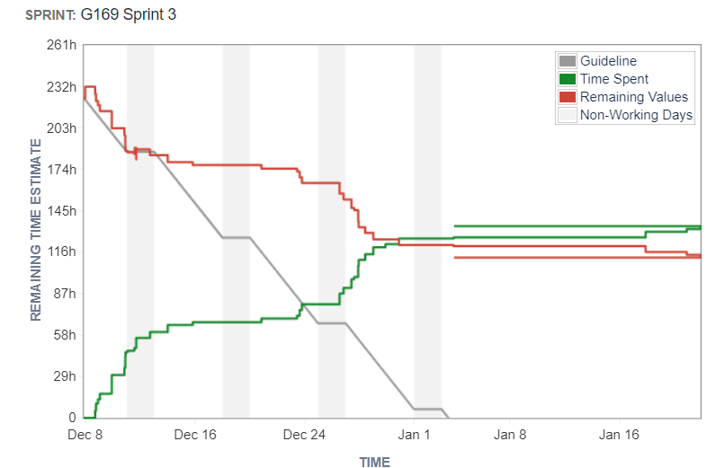
Sprint Burndown Chart
Print do JIRA após fecho da sprint

Slide 8
Sprint Review
Date: 03/12/2021
Main conclusions:
We all have done the review of each others’ work and the tests are all passing.
This sprint was very loaded with work for us.

Slide 9
Sprint Retrospective
Date:03/01/2022
What went well?
What went wrong?
The dividing of tasks is never ideal. Some issues we should not divide by all members but for evaluation purposes, we must do it.
What we’ve learned?

Slide 10
Sprint Retrospective
Date:
Action items:
Assign to the team a specific longer session of sprint planning.

Slide 11
Team performance metrics

